Slide 1
Case Finding
SIYENZA GUIDANCE

Slide 2
PICT Case Finding
SIYENZA GUIDANCE

Slide 3
Strategies for PICT Case Finding
Diagnostic Testing: testing of patients who present with signs or symptoms suggestive of HIV
Targeted Testing: testing of subpopulations of increased risk due to behavioral, clinical, or demographic characteristics, or a combination of these such as STI clients, alcohol abuse, or high burdened areas
Universal screening: testing all patients presenting for medical attention regardless of presenting complaint

Slide 4
PEPFAR COP GUIDANCE
Diagnostic testing or targeted, risk-based testing should only be used once ART coverage is over 70% in a country or SNU, and yield should be at least 10%. (p.344 COP 19 Guidance).

Slide 5
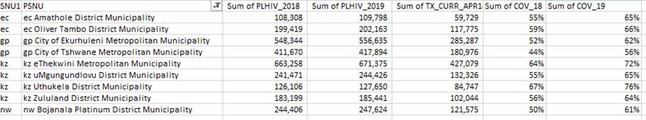
ART COVERAGE FOR SIYENZA DISTRICTS
ART coverage not >70% in any district

Slide 6
SIYENZA PICT Strategy
Case finding guidance for Siyenza facilities should be based on HIV testing coverage (proportion of eligible clients who have been tested for HIV):
TIER 1 facilities are facilities where HIV testing coverage is <80% for all clients, no matter the yield. These facilities should consider opt-out, universal screening.
TIER 2 facilities are facilities where HIV testing coverage is ≥80% with <5% yield . These facilities should consider targeted testing.
Note: 80% HIV testing coverage was a CDC SA programmatic decision

Slide 7
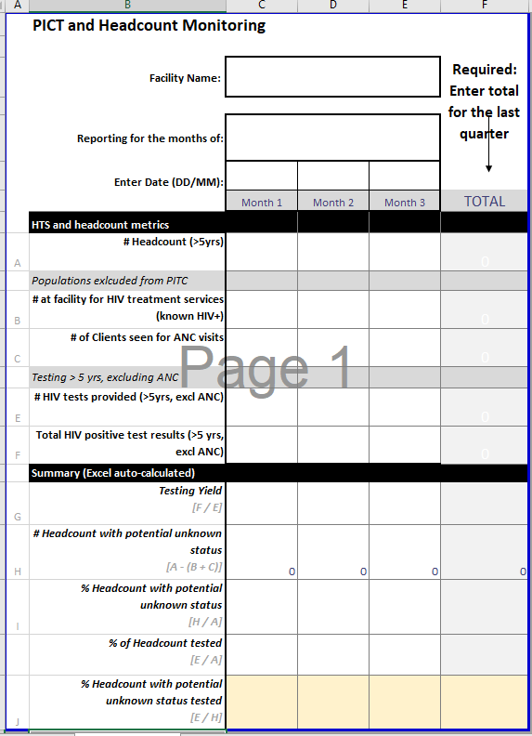
Tier 1 / Tier 2 Determination
Review current monthly headcount vs. testing coverage (Proportion of Eligible Clients) for past quarter
Use HTS metrics to calculate

Slide 8
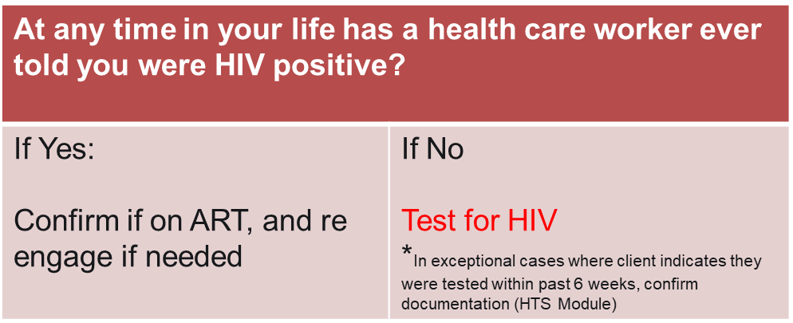
Tier 1: Facilities with a less than 80% HIV testing of proportion of the eligible headcount HIV no matter the yield: Universal Screening Approach
Screening Questions:

Slide 9
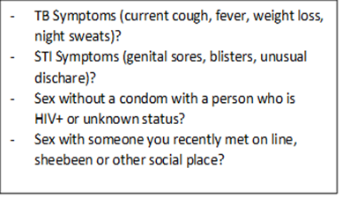
Tier 2 Facilities: (≥80% of eligible clients have been tested for HIV) but the yield is less than 5%: Targeted Testing Approach
Screening Questions:
Question | Y/N | Recommendation
At any time in your life has a health care worker ever told you were HIV positive? |  | If Yes : Confirm if on ART, and re-engage if needed If No: Go to next question
In the last year*, has a healthcare provider tested you for HIV? |  | If No: test for HIV If Yes: Go to next question
Does the client have documentation of negative prior HIV test? |  | If No: test for HIV If Yes: Screen Further for STI, TB and recent exposure
*Emphasize the change from 3 months to 12 months as this aligns with the National HTS Testing Retesting Guidelines of annual testing in absence of recent risk
If YES to any 1 of these, test for HIV

Slide 10
Index Testing
SIYENZA GUIDANCE

Slide 11
HIV Index Testing (for all positives identified through PICT): Facility Checklist
Question | Yes/ NO | If “NO” recommend
Have all counselors in the facility been trained on index testing? |  | IP to plan a training for the facility
Is index testing being implemented in the facility? |  | -IP to plan a refresher/training for all implementers in the facility - Identify an index champion to monitor implementation of index testing & the cascade -If it’s only the implementing partner service providers implementing index testing in this facility, recommend a refresher and mentoring for DOH staff
Is index testing being prioritized for newly diagnosed, unsuppressed viral load and pregnant women? |  | IP to recommend prioritizing clients likely to be infectious before those stable on treatment (e.g. adherence clubs)
Is there an index testing register / new revised NDOH register with index testing variables being utilized by the facility? |  | IP to print the index testing register and orientate implementers In absence of register, IP to provide files for index data tools.
Is there an index testing barometer in the facility? If yes is it being populated monthly? |  | IP to distribute the barometer populated with index testing targets for the facility and monitor monthly.
Do counsellors have index testing SOP’s visible in the counselling rooms? |  | IP to print, laminate and distribute pocket size index testing SOP’s (Options for Index Testing, Steps for Index and Tips for partner Elicitation) (See next 7 slides for examples)
Is there a community outreach team responsible for tracing and testing partners and children of PLHIV in the community? |  | IP should have an outreach team or CBO responsible for tracing, testing and linking all listed contacts of PLHIV

Slide 12
EXAMPLES OF INDEX TESTING Q CARDS/ SOP’s

Slide 13
Q CARD- What are the 7 steps of index testing?
Step 1. Introduce Index Testing Services to the Index Client during pre-test session or PMTCT/ART visit
Step 2. Obtain a list of sex partners and biological children < 15 with unknown HIV status
Step 3. Conduct an intimate partner violence (IPV) risk assessment for each named partner
Step 4. Determine the preferred method of partner notification or child testing for each named partner/child
Step 5. Contact all named partners and biological children <15 with unknown status using preferred approach
Step 6. Record outcomes of partner notification and family testing
Step 7. Provide appropriate services for children and partner(s) based on HIV status

Slide 14
Detailed Steps for Index Testing Services
Step 1: Introduce Index Testing Services to the Index Client during pre-test session or PMTCT/ART visit
Use Index Testing Talking Points to introduce partner/family testing to the index client and complete
Index Client Information Form
Use the Partner/Children Elicitation Forms to record partner(s)’/child(ren)’s names and contact information
Step 2: Obtain a list of sex and needle-sharing partners and biological children < 12 with unknown HIV status
Use the Partner Information Form to document results of IPV screening and preferred partner notification and/or child testing method.
Complete one form for each named partner
Exclude partner/s posing a high risk of IPV; refer index client to IPV/OVC services are available and discuss other options for disclosure.
Step 3: Screen all named partners for intimate partner violence (IPV)
.
Provider Referral: Initiate partner home visit scripts
Community Based: Confirm a day/time the provider will test the child(ren) in the home.
Mutual agreement Referral: Provide referral card and disclosure script; agree that client will refer partner or bring the child for HTS within 7 days.
Dual Referral: Coach client on joint disclosure; Make a plan for when and where joint disclosure will take place; Offer HTS to partner.
Client Referral: Coach client on disclosure; Provide “Tips for Telling Your Partner about HIV” and referral slip
Facility Based: Confirm an appointment to test biological children <15
Step 4: Determine the preferred method of partner notification or child testing for each named partner/child and record on Partner Information Form and/or Biological Children Form
Step 5: Visit all named partners and test all biological children <15 with unknown status using the preferred approach
Was partner successfully contacted?
Was the child tested?
Yes
No
Step 6: Record partner notification and family testing outcomes on the Outcome of Testing Forms
Record successful partner contact or child test (including HIV status) on Outcome of Partner/Children Testing Form
If Contract Referral, initiate provider referral for partners or home testing for children after 7 days; otherwise record unsuccessful contact on Outcome of Partner/Children Testing Form
Step 7: Provide appropriate services for children based on HIV status, seroconcordant/discordant partners, or work to support disclosure

Slide 15

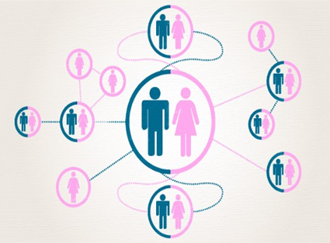
Five Tips for Partner Elicitation
Introduce partner notification in pre-test counseling session
Use appropriate questions/ language to ask about partner(s) and children
Assure clients of the confidentiality of services: partners will be traced and be offered testing for the ‘National HTS campaign’
There is no need for client to disclose their HIV status, partners will be traced and offered a test anonymously.
Use humor and slang to probe for additional partners and make clients feel comfortable with you
Use brief motivational interviewing to create rapport with clients
Act natural and do not make the elicitation weird/ judgmental and stressful for the client

Slide 16
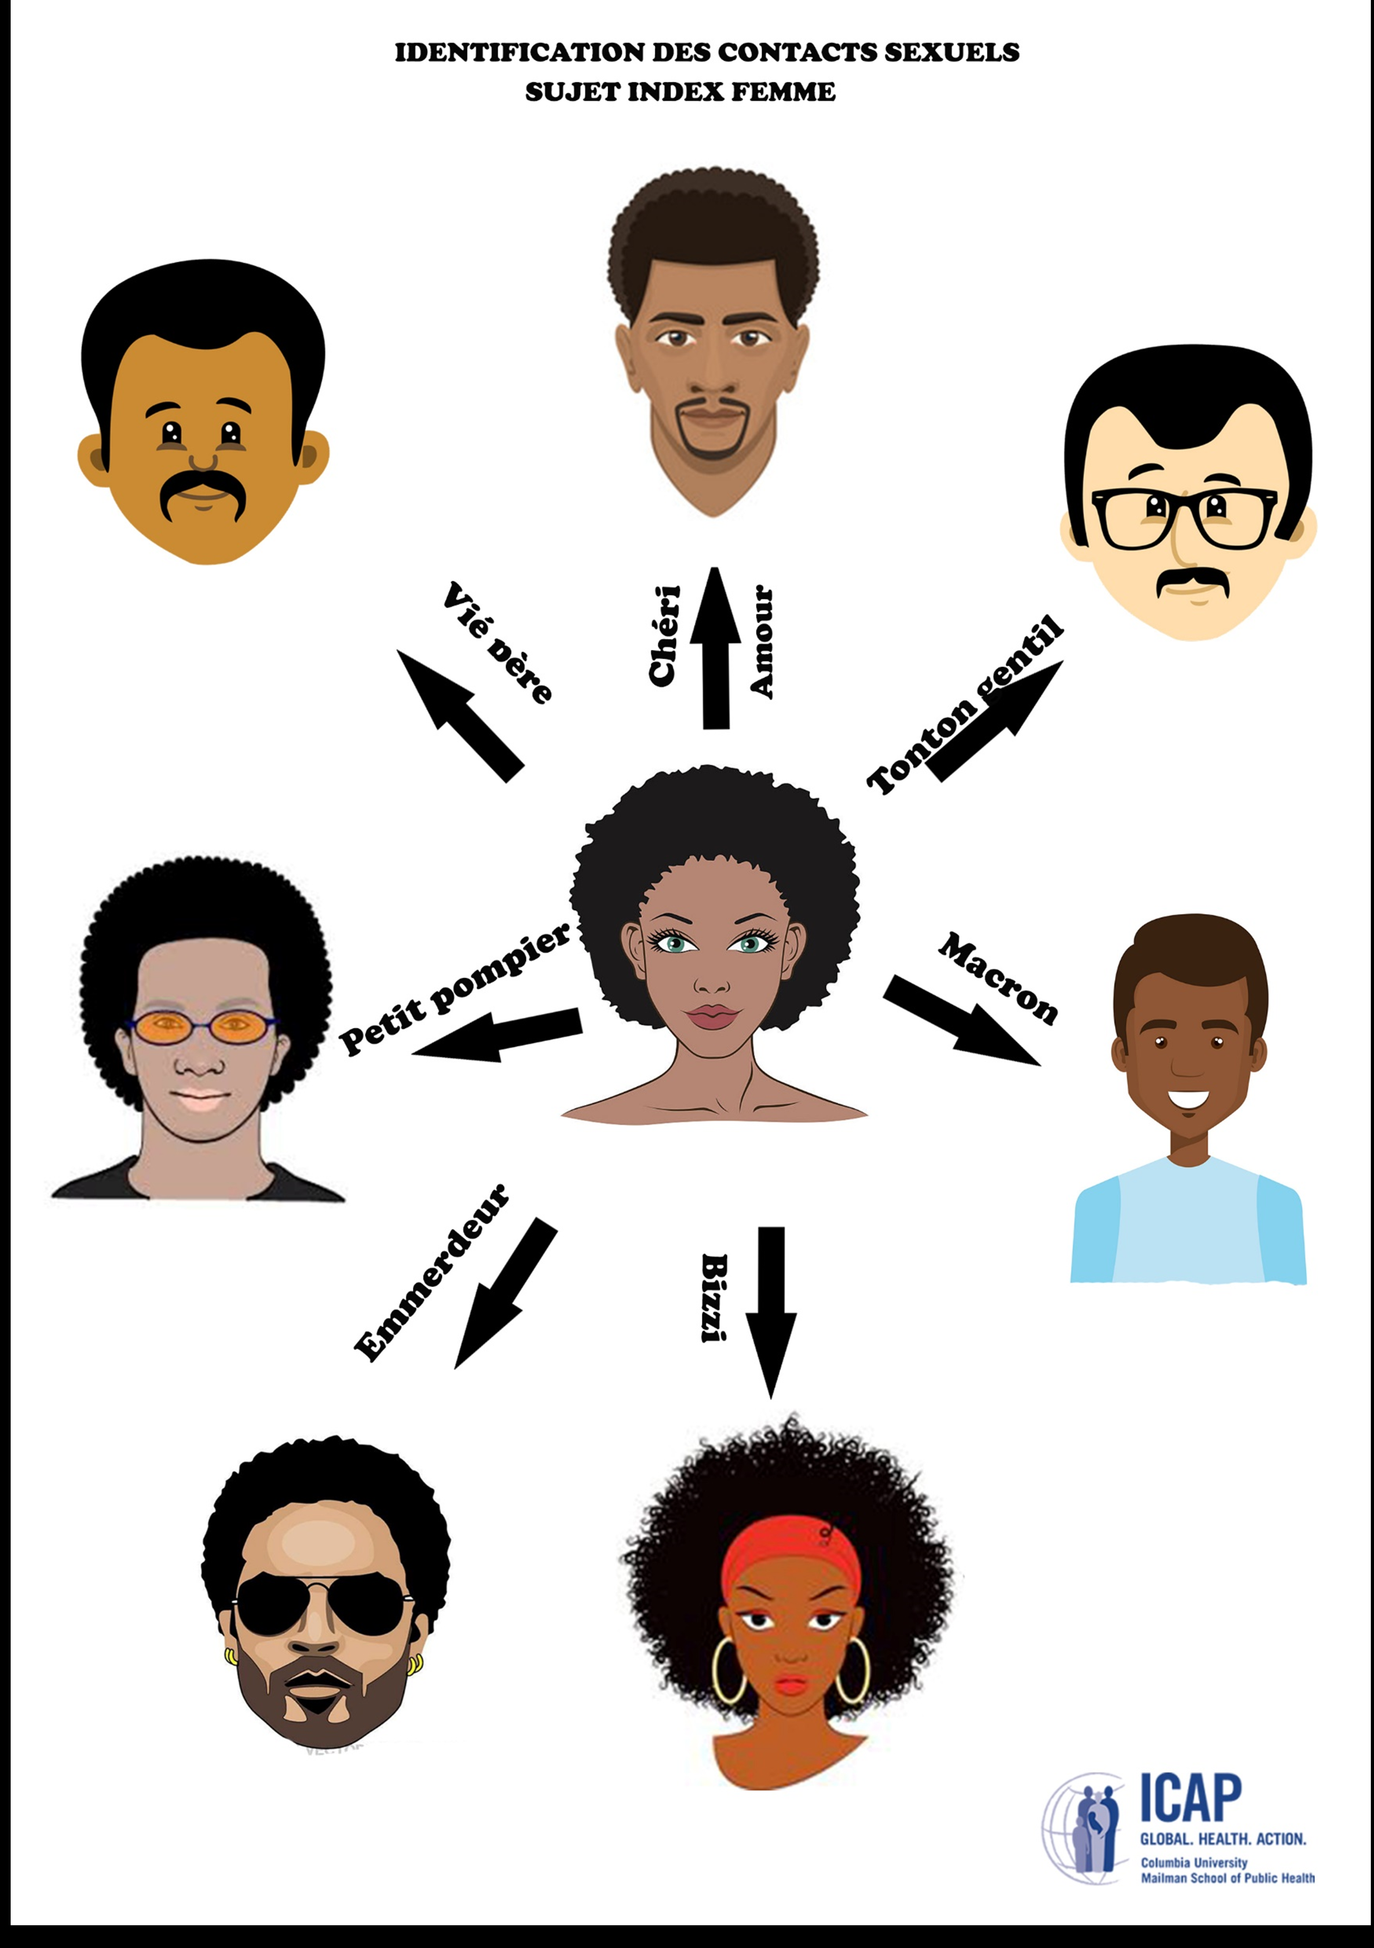
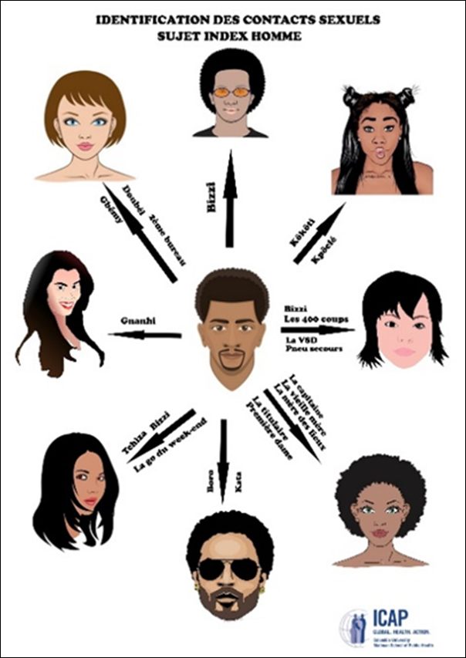
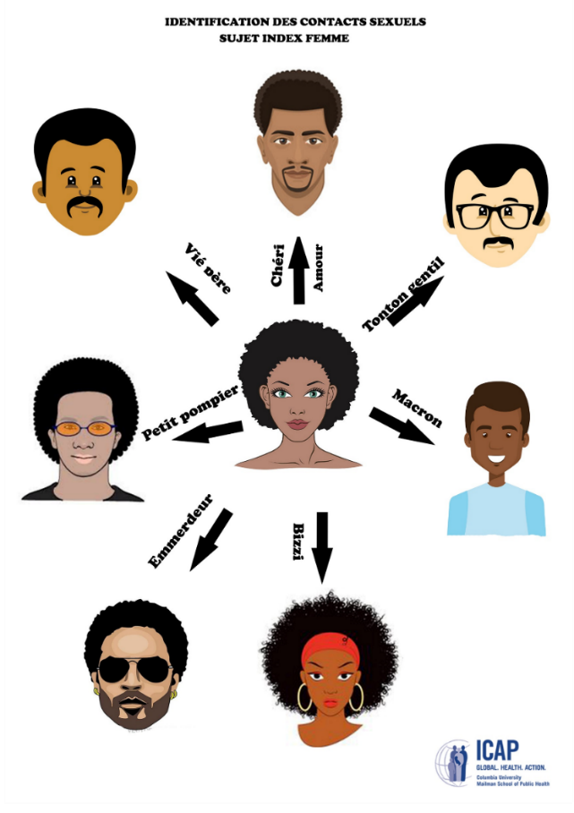

Use Humor and Appropriate Slang to Probe and Make the Client Feel Comfortable
After client responds about ‘main partner’, probe for additional partners using slang terms that are common in the community
Ask expert clients, including AGYW, to give you popular terms used in the community

Slide 17


Popular Slang Terms used by men
iKati
Ikhwapha/umakhwapheni
Sugar Baby
Ohlekisana naye (older men)
Ume ngomlenze owodwa ngempela? (Probing )
i-Vrou
uMuntu wakho
Oncokola Naye
Moghel
Wifey
Bae
Baby mamma
Sparewheel
Stokko
Nyatsi
Side dish/ side kick/ side chick/side speck
oMamncane
oSisterz
Medi
iThekeni
Cherrie
uMadam
oMaBhebeza
Mghwanthi
Khwaps

Slide 18

Possible Slang Terms used by women
Daddy
Brotherz
Mjita
Bae
Boo
Valentine
Sweety/Soulmate/Better Half
Umngani wesilisisa (Appropriate for older women)
Ishende
Minister of Finance/ Housing/Transport
Minister of wobumnandi
Sugar Daddy
U-Baba
uMuntu wakho
uMy person (Mperson)
Isidikiselo
Ikhwapha/makhwapheni
Mr Fun

Slide 19
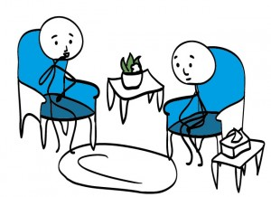
Use Brief Motivational Interviewing as a Strategy for Partner Elicitation
Open-ended Questions
(‘Tell me about’…or ‘what else?’)
Affirming Statements
(‘I appreciate that it took a lot of courage for you to discuss your sexual partners with me today’)
Reflective Listening
(‘If I hear you correctly you are saying’…..or ‘it sounds like you feel afraid because of…..’)
Summarize the Conversation
(‘Today we discussed a, b, c, and we are agreed on a, b, c and our next steps are 1, 2, 3’)

